Slide 1
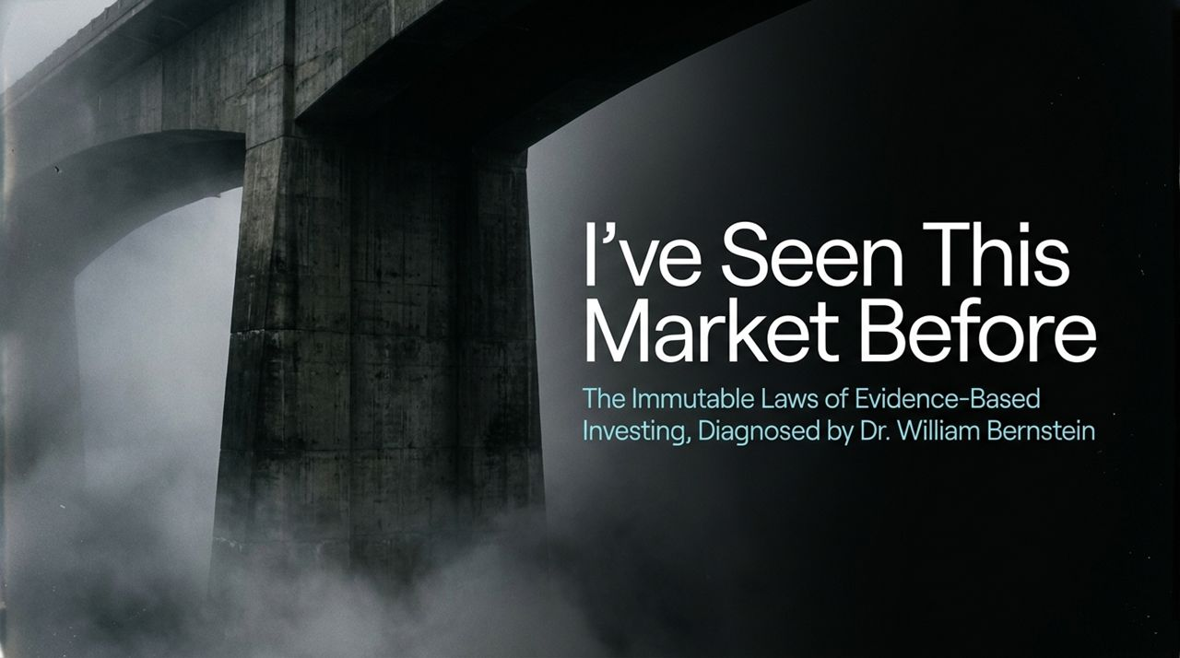
Notes:
Good morning/afternoon, everyone. Today, we are walking through the core principles of evidence-based investing, framed by the insights of Dr. William Bernstein—a neurologist turned investment author and advisor.
If you have followed the markets recently, you’ve likely noticed a familiar sensation: intense enthusiasm around groundbreaking technology, soaring market valuations, and a growing narrative that traditional defensive assets are obsolete.
Dr. Bernstein’s unique background gives him a distinct perspective. As a practicing physician, he approached finance not with Wall Street hype, but with scientific rigor. Over the course of today's talk, we will explore 16 core principles that diagnose current market behavior, re-evaluate risk, and outline a disciplined strategy to preserve and grow wealth.
Let's dive into the diagnosis.
I’ve Seen This Market Before — William Bernstein
https://www.youtube.com/watch?v=Eu_NV9nR1uY

Slide 2

Notes:
To understand Dr. Bernstein's philosophy, you have to understand where he comes from. He spent years practicing neurology before writing The Intelligent Asset Allocator in 1999 and The Four Pillars of Investing.
He often humbles himself by saying, 'I'm a classic example of how it's better to be lucky than smart... I was just first in line when the web came online to put out academic investing work for the public.' But his transition from medicine to finance carries a critical lesson: evidence matters.
Just as a physician wouldn't prescribe a treatment without reviewing peer-reviewed clinical trials, an investor shouldn't build a financial future on sensational headlines or financial news pundits.
His approach strips away emotion and replaces speculation with historical evidence, academic theory, and strict financial hygiene.

Slide 3
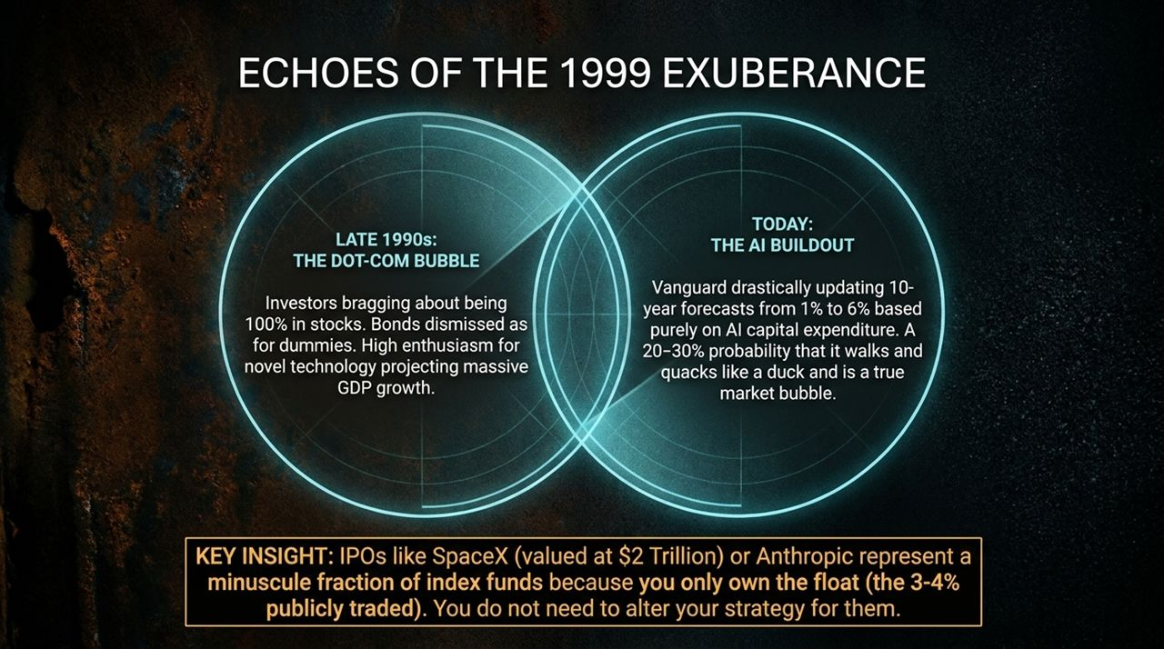
Notes:
Look at the parallels between the late 1990s and today. In the late 90s, we saw widespread euphoria. Investors were boasting about being 100% in equities, dismissing bonds as useless. High enthusiasm for the internet led to extreme GDP and growth projections.
Fast forward to today’s AI buildout. We see similar psychological patterns. Consider this: Vanguard’s capital market models recently shifted their 10-year nominal stock return forecast from 1% to 6% based largely on AI capital expenditures.
Dr. Bernstein estimates there is a 20% to 30% chance that this walks, quacks, and acts like a true market bubble. While not a guaranteed crash, historical precedents caution against abandoning a balanced portfolio to chase high-flying tech.
A common concern among investors is upcoming mega-IPOs like SpaceX or Anthropic. People worry that if SpaceX enters the S&P 500 at a massive valuation, it will skew the index. But remember the concept of float: index funds only hold the publicly traded portion. If only 3% to 4% of a company's shares are publicly traded, its weight in a total market fund remains tiny (around 0.1%). There is no need to alter your core strategy.

Slide 4
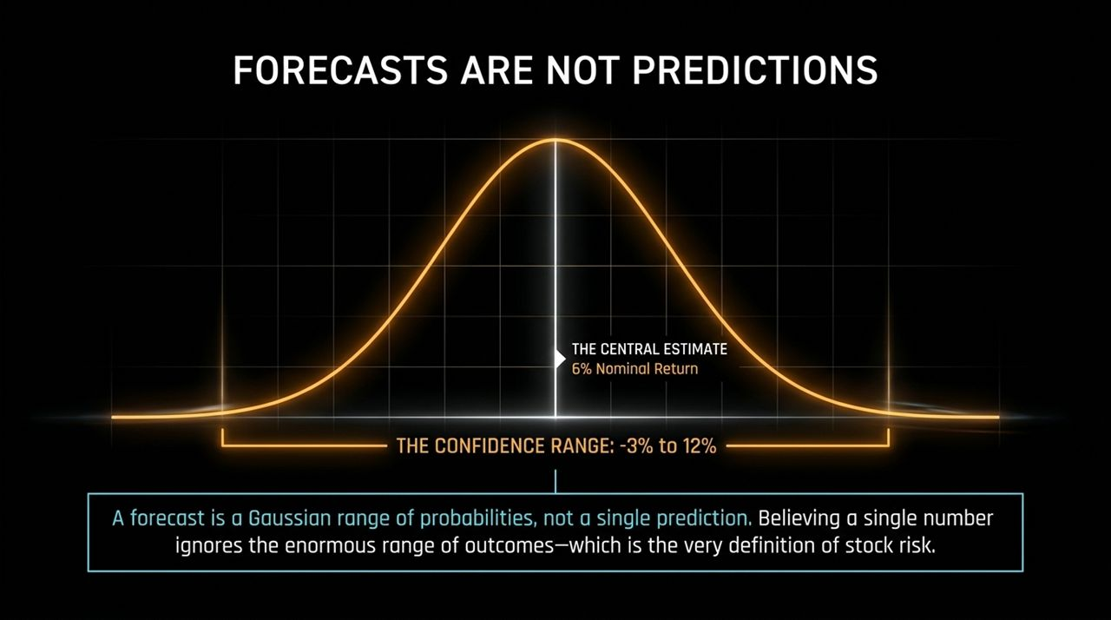
Notes:
One of the most dangerous mistakes an investor can make is treating a financial forecast as a precise prediction.
When an institution like Vanguard predicts a 6% return over the next decade, that number is simply the median point of a broad probability distribution—a Gaussian bell curve.
Within a standard 95% confidence interval, that 6% point estimate actually spans anywhere from -3% to +12% annualized returns. That is a massive range of possible outcomes.
Believing in a single deterministic number ignores the real variance of equities—which is the exact definition of stock risk. Prepare for the full distribution of outcomes, not just the central point estimate.

Slide 5
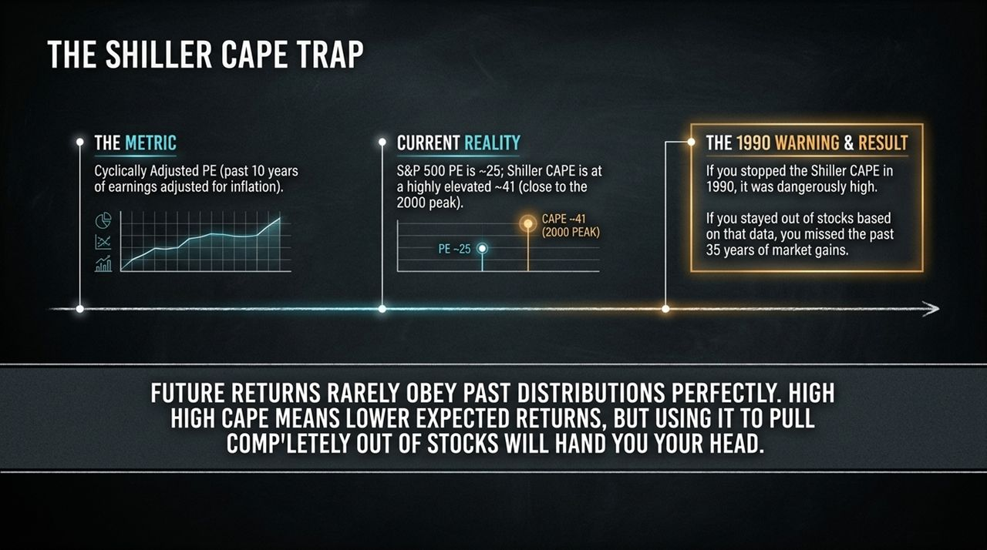
Notes:
The Cyclically Adjusted Price-to-Earnings (CAPE) ratio, pioneered by Robert Shiller, evaluates stock prices against average inflation-adjusted earnings over the past 10 years.
Right now, standard S&P 500 P/E sits around 25, but the Shiller CAPE is hovering near 41—levels historically seen around the peak of the 2000 tech bubble.
Does this mean you should sell all your stocks today? Absolutely not. This is what Dr. Bernstein calls the 'CAPE Trap'.
If you had looked at the CAPE ratio in 1990, it appeared historically elevated. Had you used that data to exit the stock market completely, you would have missed out on 35 years of wealth accumulation.
In econometrics, market valuations are non-stationary. High CAPE tells us that future expected returns are likely lower, but using it as a market-timing trigger to abandon equities entirely is a recipe for underperformance.

Slide 6

Notes:
To succeed as a long-term investor, you must redefine how you view risk.
Academic finance measures risk via standard deviation—month-to-month volatility. Our evolutionary 'Serengeti Brain' reacts viscerally to volatility. When the market falls 20%, our primitive limbic system triggers a fight-or-flight response, signaling us to flee.
However, short-term market fluctuation is Perceived Risk. Real Risk is long-term portfolio depletion—finding yourself running out of money and living under a bridge at age 70.
Real risk manifests in two ways: investing too aggressively near retirement and experiencing a severe market crash, or investing too conservatively in cash and watching inflation erode your purchasing power.
Your goal as an investor is not to maximize vanity returns, but to minimize the odds of running out of capital in retirement.

Slide 7

Notes:
Dr. Bernstein popularized a phrase in personal finance: 'If you've won the game, stop playing.' Calling investing a game is a metaphor, but the stakes represent your livelihood.
Here is the 3-step blueprint to secure your essential living expenses:
Calculate Residual Needs: Take your annual living expenses and subtract guaranteed income like Social Security. If you spend $70k and get $30k from Social Security, your residual need is $40,000 per year.
Determine the Target: Multiply that annual residual need by 25 to 30 years. At $40k/year, your target is $1,000,000.
Lock It In: Place that target amount into a risk-free asset that defeases (guarantees) your future liability.
Once you have accumulated enough to cover your baseline human existence, take unnecessary risk off the table. Don't jeopardize what you need to chase what you don't need.

Slide 8

Notes:
How do you lock in those guaranteed living expenses? Through a Treasury Inflation-Protected Securities (TIPS) ladder.
In 1999, TIPS offered an extraordinary 4% real yield. Today, they offer around 3% real yield—which is historically attractive because it guarantees purchasing power above inflation.
To construct a ladder, each rung matures in a successive year, providing cash to cover annual expenses. Because primary US Treasury auctions only issue 5-, 10-, and 30-year TIPS, you build a complete ladder by purchasing bonds in the secondary market using platforms like tipsladder.com.
Watch out for the Inflation Factor Trap when buying secondary TIPS. A 30-year TIPS issued 15 years ago might show a discounted price of $900 for a $1,000 face value. However, because 15 years of inflation adjustments have accrued, the actual principal cost might be $1,500. Always account for the inflation index ratio before purchasing.

Slide 9
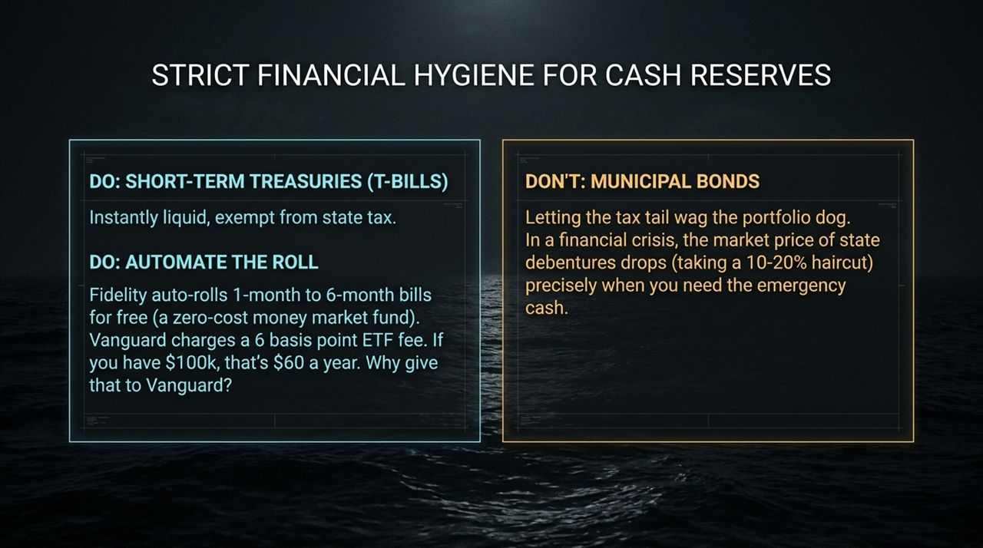
Notes:
Managing short-term liquidity and emergency cash requires strict financial hygiene.
DO use Short-Term Treasuries (T-Bills): They are liquid, state-tax exempt, and backed by the full faith of the US government.
DO Automate: Brokerages like Fidelity allow you to auto-roll T-Bills upon maturity for free. This essentially creates a zero-expense-ratio money market fund. While Vanguard offers short-term Treasury ETFs charging 6 basis points, automated T-Bill rolling saves that fee entirely—keeping $60/year per $100k in your pocket.
DON'T rely on Municipal Bonds for Emergency Cash: Do not let the tax tail wag the investment dog. During financial panic (like 2008), municipal bonds can suffer liquidity droughts, trading at 10% to 20% haircuts right when you need emergency liquidity.

Slide 10
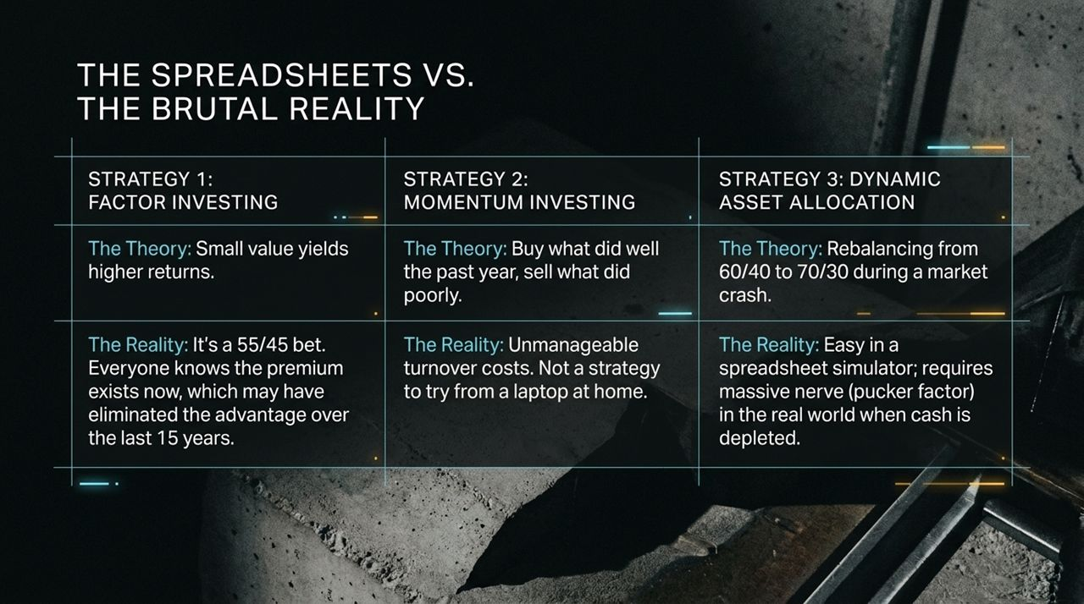
Notes:
Strategies that look flawless on backtests often crumble when exposed to human behavior.
1. Factor Investing (Small-Cap Value): Theory suggests small-value stocks yield higher returns over time. In reality, now that everyone knows about the value factor, the premium has narrowed over the past 15 years. It's a 55/45 bet—and holding through decades of underperformance requires extreme patience.
2. Momentum Investing: Buying recent winners sounds straightforward, but rapid portfolio turnover creates heavy transaction costs and tax drag. It is not a strategy to execute from a laptop.
3. Dynamic Asset Allocation: The idea of shifting from 60/40 to 70/30 during market drops is mathematically appealing. But executing this requires immense emotional fortitude. Rebalancing into falling equities when your portfolio has plummeted isn't like flying a simulator—it brings a real-world 'pucker factor' that causes most investors to freeze.

Slide 11
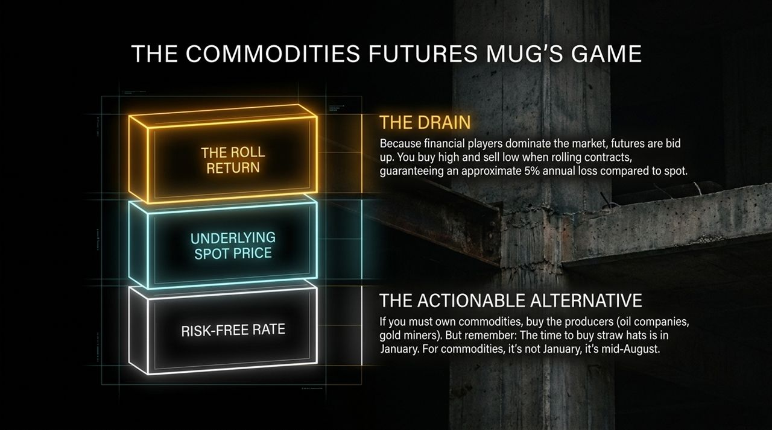
Notes:
Investing in commodity futures funds is what Dr. Bernstein bluntly labels a 'mug's game.'
Commodity returns consist of spot prices, risk-free interest, and the roll return. Because institutional investors dominate futures markets today, expiring contracts sell high and roll into costlier future contracts. This creates a negative roll yield, dragging returns down by roughly 5% per year compared to spot prices.
If you seek commodity exposure, buy the producers—oil companies or gold miners—which generate cash flows.
And remember the seasonal rule of thumb: 'The time to buy straw hats is in January, not August.' Don't rush into commodities after they have already rallied.

Slide 12
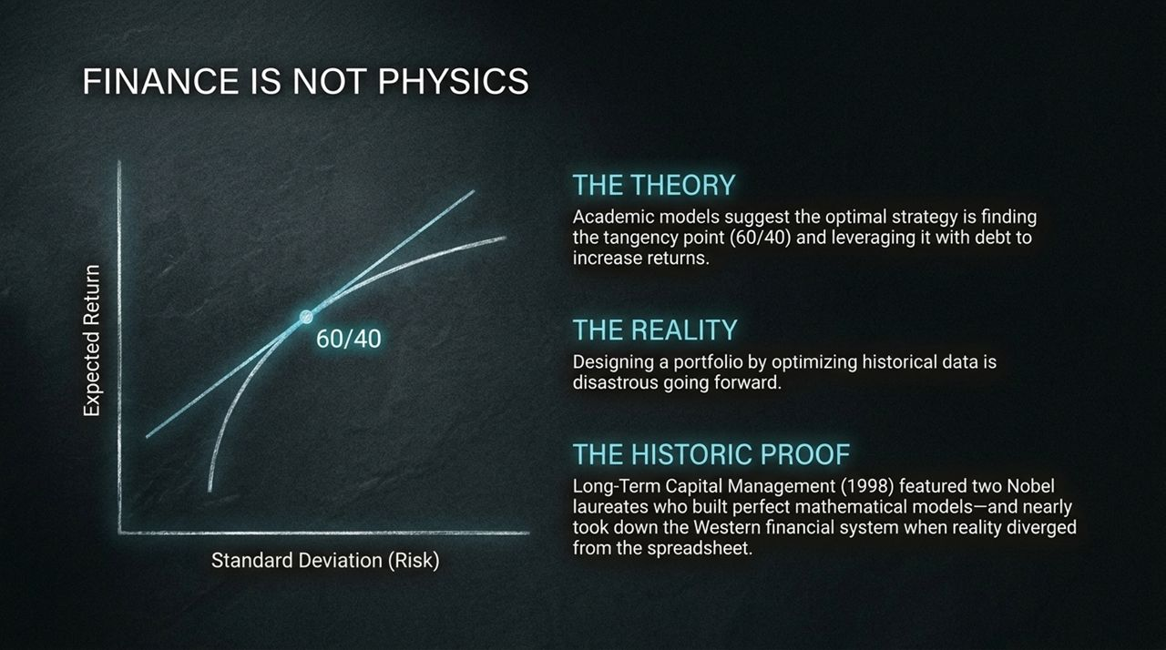
Notes:
Academic finance models like Modern Portfolio Theory argue that you should find the optimal tangency point (such as a 60/40 stock/bond split) and leverage it up with debt to maximize returns.
This assumes financial markets behave like physics—where formulas predict outcomes with precision. But finance is a behavioral science driven by human emotions.
Designing a forward-looking portfolio by over-optimizing past data usually fails. Look at Long-Term Capital Management (LTCM) in 1998: operated by two Nobel laureates with mathematical models, their leverage strategy collapsed during market disruption, requiring a Wall Street bailout to prevent systemic failure. Simplicity beats fragile optimization.

Slide 13

Notes:
We are witnessing a major generational shift in retirement planning.
The Baby Boomer generation benefited from a fortunate alignment: rising career compensation paired with long-term secular bull markets.
Millennials face a different economic landscape. Will Social Security be there? Yes, but expect increased means-testing.
While lower-wage earners see Social Security replace up to 90% of pre-retirement earnings, high earners and professionals (like physicians) should plan for Social Security to replace only 15% to 20% of their income. High earners must build independent capital self-reliance.

Slide 14
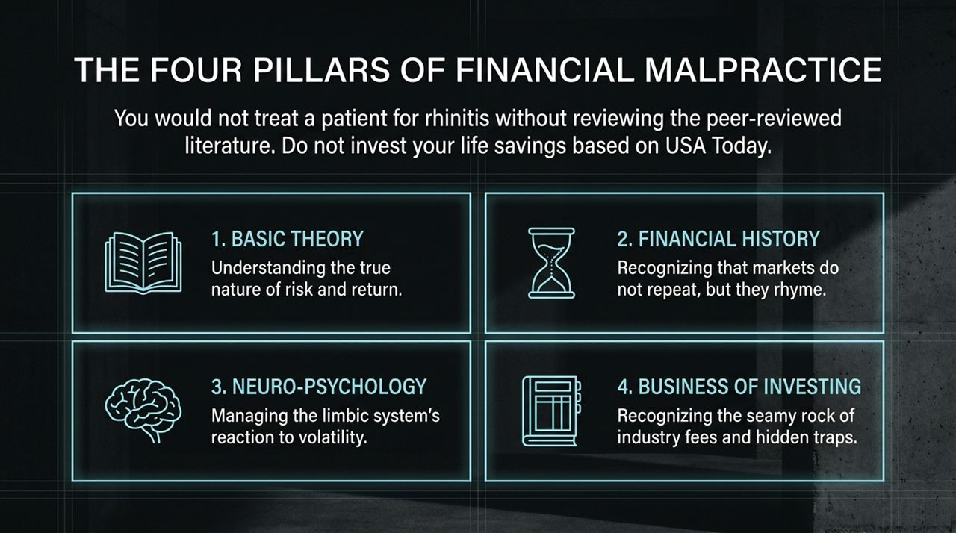
Notes:
As a physician, you wouldn't treat a minor illness like rhinitis without grounding your clinical judgment in medical evidence. Why manage your life savings based on headlines or media commentary?
To avoid financial malpractice, master the Four Pillars:
Basic Theory: Understand the fundamental link between risk and expected return.
Financial History: Markets don't repeat identically, but behavioral manias and crashes rhyme across centuries.
Neuro-Psychology: Recognize how your limbic system reacts to market volatility so you can discipline yourself during panics.
The Business of Investing: Understand industry fee structures, high expense ratios, and hidden costs that siphon wealth from investors.

Slide 15

Notes:
We close our core framework with a profound takeaway from Dr. Bernstein:
'Finance isn't a game where the person with an IQ of 160 beats the person with an IQ of 130. The person who wins the finance game is the one with the most discipline. It is the one who is best able to control their limbic system.'
Intellectual brilliance will not protect you if you panic-sell at market bottoms or buy into euphoria at market tops.
Success in investing stems from emotional regulation, adherence to evidence, and maintaining operational discipline.

Slide 16
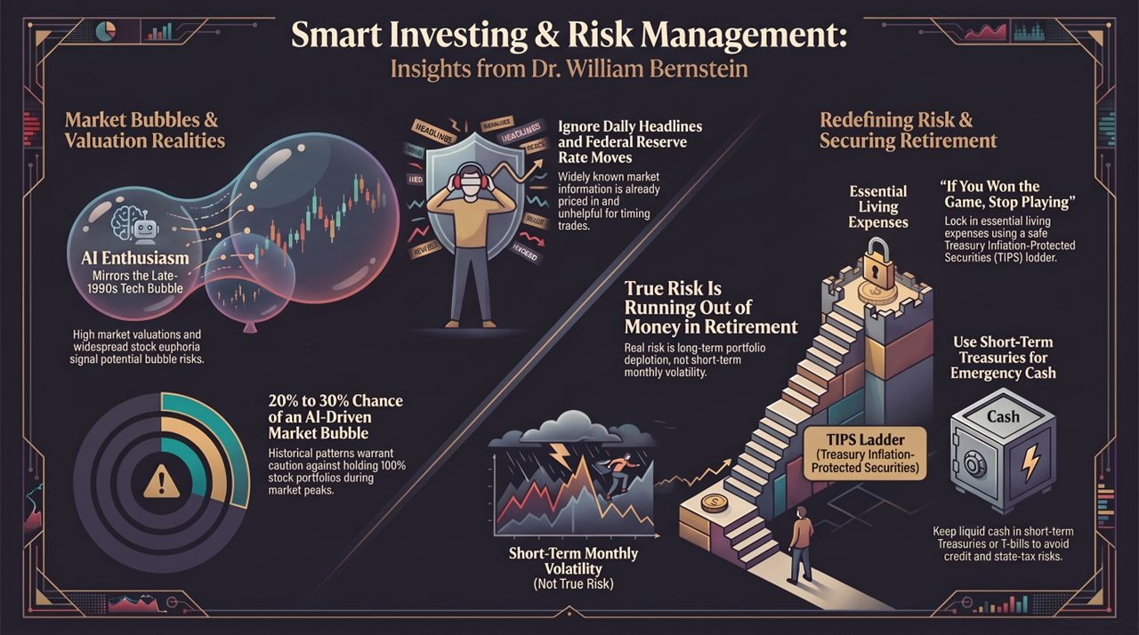
Notes:
To bring everything together, here is our actionable summary blueprint:
Ignore Daily Headlines & Fed Moves: Publicly known economic news is already priced into the market. Do not time trades based on headlines.
Respect Valuation Realities: While an AI-driven market bubble is possible (20–30% probability), avoid panicked exits from global equities.
Redefine Risk: Focus on avoiding portfolio depletion over decades, rather than short-term monthly price fluctuations.
Lock in Living Expenses: Once you hit your target number, construct a TIPS ladder to defease essential retirement expenses.
Maintain Clean Cash Hygiene: Hold emergency liquidity in short-term T-Bills to avoid credit risks and state taxes.
Thank you for your time. Let's open the floor to questions.
I’ve Seen This Market Before — William Bernstein
https://www.youtube.com/watch?v=Eu_NV9nR1uY

